Slide 1



Dates: 10/02/26; 24/02/26; 03/03/26; 13/03/26; 17/03/26
Facilitator: James Mwewa

Slide 2
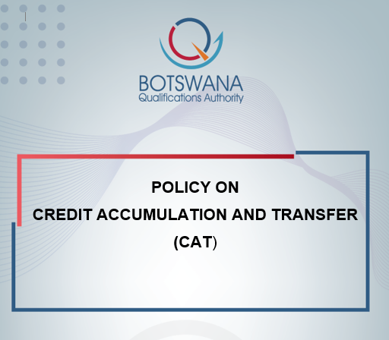

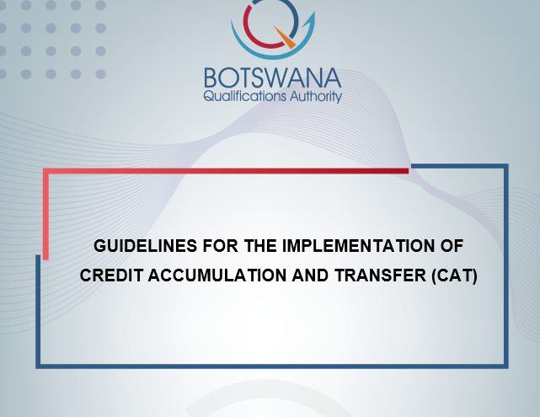
Presentation Outline
Demystifying CAT Systems – Concepts, Definitions and Benefits
Group Work – Implementation Plan and M&E Matrix
Development and Implementation of Institutional CAT Procedures in Botswana

Slide 3
Demystifying CAT Systems:
Concepts, Definitions and Benefits

Slide 4
The NCQF Eco-systemic View
NCQF
CAT
MCs
RPL
Quality Assurance System
Qualification Standards
National Policies, Developmental Plans and Legislation
Assessment Standards
Occupational Standards
National Education, Training and Qualification Systems
Referencing Policy

Slide 5
The NCQF Eco-systemic View…Implications
Include in internal procedures mechanisms for recognising credits obtained through RPL and micro-credentials
Provide access to individuals with RPL and micro-credential certifications
Allow for learners to transfer to other courses or institutions credits acquired via RPL and micro-credentials

Slide 6


CAT Systems – what are they?
Mode for validating and recognising learning through the recognition of credits
Used to recognise learning outcomes regardless of learning context
Systematic way of describing an educational programme by attaching credits to its components
‘Credit systems’ means a transparency tool for facilitating the recognition of credit(s). These systems can comprise, inter alia, equivalences, exemptions, units/modules that can be accumulated and transferred, the autonomy of providers who can individualise pathways, and the validation of non-formal and informal learning.
EQF Recommendation (2017)
Credits
Credits
Context A
Context B
It is a form of currency used to exchange acquired learning outcomes for a qualification

Slide 7
Botswana’s CAT System
CAT System
Premised on the Policy and Guidelines (2025) - overarching national documents that set the bases on which education and training providers will develop and implement their institutional credit accumulation and transfer procedures.
A transparency, systematising and harmonising tool for assigning, awarding, accumulating and transfer of credits.
A tool that will support comparability and recognition of qualifications, as well as flexible learning pathways, articulation, mobility, progression and LLL.

Slide 8
Recalling Key Definitions
“Credit” means a measure of the volume of learning required for a qualification or part qualification, quantified as the number of notional study hours required for achieving the learning outcomes specified for the qualification or part qualification whereby 1 credit is equated to 10 notional hours of learning.
“Credit accumulation” means the totalling of relevant credits required to complete a qualification or a part-qualification.
“Credit transfer” means: (1) the vertical, horizontal or diagonal relocation of credits towards a qualification or part-qualification on the same or different level, usually between different programmes, departments or institutions.
(2) the process of allowing individuals who have accumulated credits in one context to have them valued and recognised in another context.

Slide 9

Legal Basis for Implementation of a CAT System in Botswana
Botswana Qualifications Authority is mandated by the BQA Act No. 24 of 2013 – section 4 (2), to, among other things:
…(d) develop, implement and maintain an overarching national credit and qualifications framework;
2) …(f) develop policy and criteria for…Credit Accumulation and Transfer System.

Slide 10

Purpose of a CAT System in Botswana
To provide a common understanding and unified framework for implementation of credit accumulation and transfer across the education and training sector, as well as for the designing and quality assurance of learning programmes.

Slide 11

Objectives of the CAT System in Botswana
Support access to education and training, and flexibility of learning pathways.
Enhance lifelong learning and employability of learners.
Create a common understanding of CAT and its application in Botswana.
Enhance intra and inter institutional mobility of learners within Botswana.
Facilitate the vertical, horizontal and diagonal mobility (in-country and international).
Enhance the comparability of learning outcomes and qualifications.
Promote equity and fairness in the country’s education and training system.
Support the internationalisation agenda of Botswana’s education and training.
Contribute to the enhancement of quality and relevance of qualifications in Botswana.

Slide 12

Scope of Botswana’s CAT System
All sectors of the education and training system and levels of the NCQF.
BQA, education and training providers (public and private), regulatory bodies, curriculum developers, industry, non-governmental organisations, private entities, recognised professional bodies and learners.
Qualifications, part-qualifications and micro-credentials.
Qualifications acquired from formal, informal and non-formal learning contexts.

Slide 13





Benefits of CAT System in Botswana
Multi-skilling and up-skilling of employees
Equal learning opportunities for all
Facilitates easy mobility of learners and workers
Promotes lifelong learning through flexible learning pathways
Duplication of learning
RELEVANT AND
QUALIFICATIONS

Slide 14
Responsibilities of Stakeholders in the Implementation of the National CAT System
Clearly defined in Section 9.0 of the CAT Policy
We all have a role to play
Need to collaborate with BQA and other stakeholders

Slide 15
CAT System Implementation Approaches
Policy
(National Level)
Guidelines
(Sub Framework/ Sector Level)
Procedures
(Institutional Level)
Qualification A
Qualification B
Faculty/School A
Faculty/ School B
Country A
Country B
Institution A
Institution B

Slide 16
CAT System Guiding Principles
Promote Learner Mobility – no Duplication of Learning
Systems, Procedures should be Transparent, Fair, Flexible & easy to use
Decisions –Timely, Academically Defensible, Equitable, based on LOs
Credits for Non-formal or Informal Learning = Credits for Formal Learning
Promotes Institutional Autonomy
Academic Rigour and Integrity of Qualifications not to be Undermined
Institutional Commitment and Cooperation is Key
Subject to Rigorous Quality Assurance
1
2
3
4
5
6
7
8

Slide 17
Key Concepts in CAT
Types of credit transfers: vertical, horizontal and diagonal.
Modalities of credit transfer:
Block Credit Transfer: entails reducing the total credit of the receiving programme by the amount of credits from the completed programme.
Course Exemption: An individual may be exempted from taking a specific course or module of a programme based on the learning achieved in previous studies. This is applicable to both completed and uncompleted programmes.

Slide 18
Key Concepts in CAT…Cont’d
The Notional Hour Approach:
The Botswana CAT System is based on the notional hour approach.
In this approach, the hours referred to here include time spent on all the learning activities of the student (workload), inclusive of contact time (lecture time, tutorials, labs), private study, research, assignment writing, examinations, etc.
The following assumptions are made:
The average student accumulates 8 study hours per day. This amounts to a 40 hours/ week.
Undergraduate programmes are generally based on a 30-week full-time academic year. At 40 hours per week this amounts to 1200 hours per year.
10 notional hours constitute one credit (that is, 10 notional hours = 1 credit, 1200 notional hours = 120 credits).

Slide 19
The CAT System Value Chain
1
Allocation of credit to components of a LP
2
Awarding of credit
3
Accumulation of credit
4
Transferring of credit

Slide 20
Steps in Allocating Credits to a Learning Programme
1
All learning programme components are described
4
Workload needed for a learner to complete the learning activities is estimated
5
Proposals are collected, analysed and the estimated workload is expressed in credits
2
3
Learning outcomes of each programme component are defined
Learning activities are described

Slide 21
Computing Learner Workload
Learner workload is an estimation of the time the learner typically needs to complete all learning activities such as lectures, seminars, projects, practical work, work placements/ work-based learning/ experience and individual study required to achieve the defined learning outcomes.
Learner workload is the basis upon which credits should be allocated under the Botswana CAT System.
Three components constitute learner workload: teaching, learning and assessment.
The sum total of learner workload includes the following:
Number of contact hours.
Number of independent study hours.
Number of hours spent on assessment tasks: formative and summative.
Number of hours spent on Work-Based Experience (WBE)/ attachments.

Slide 22
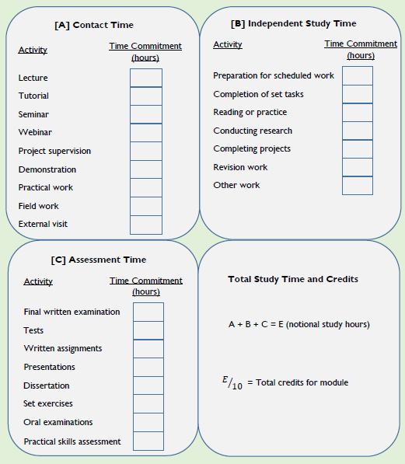
Allocating Credits to a Learning Programme - Examples
Activity | Time Commitment (notional hours)
Contact time
Lectures | 48
Tutorials | 6
Group Seminars | 4
Field Trips | 4
Demonstrations | 6
Total | 68
Independent study time (indicative)
Preparation for scheduled sessions | 10
Writing assignments | 8
Reading module material | 20
Revision | 10
Total | 48
Scheduled assessment time
Tests | 1
Final Examination | 3
Total | 4
Grand Total | 120

Slide 23
Allocating Credits to a Learning Programme – Examples…Cont’d
Consider a semester module (based on 15 weeks) with 4 hours of lecturing per week, 2 hours of tutorials per week, 2 hours of laboratory practical work per week, 4 hours of self-directed learning per week, 10 hours of formative and summative assessment:
Formula for calculating credits (where TC = Total Credits):
TC= lectures+ tutorials + practical works + internships + projects + assessment
10
TC = (4x15 (lecture) + 2x15 (tutorials) + 2x15 (practical) + 4x15 (self-study) + 10 (assessment))/10 = 190/10 = 19

Slide 24
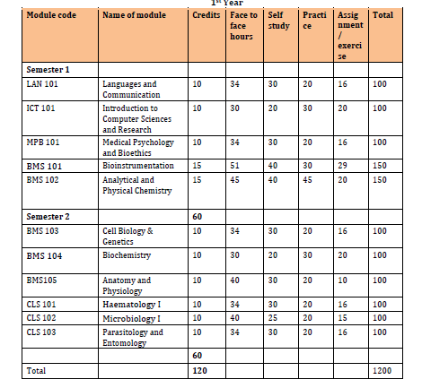
Allocating Credits to a Learning Programme – Examples…Cont’d
First Year of Biomedical Laboratory Sciences Programme

Slide 25
Examples of Regional Credit Systems
Region | Name/ Title of CAT System | Definition of Credit
Southern African Development Community (SADC) | Guidelines for Southern African Development Community Credit Accumulation and Transfer Systems (SADC-CATS) | 10 notional hours = 1 credit
East African Community (EAC) | East African Credit Accumulation and Transfer System (EACATS) in Higher Education | 10 notional hours = 1 credit
European Union (EU) (Bologna Countries) | European Credit Transfer and Accumulation System (ECTS) in Higher Education | 25-30 hours = 1 ECTS credit
United Kingdom (UK) | Credit Accumulation and Transfer Systems (CATS) | 10 notional hours = 1 credit
Asia-Pacific (APAC) | University Mobility in Asia and the Pacific (UMAP) Credit Transfer Scheme (UCTS) | 38-48 hours = 1 UCTS credit
Latin America (LATAM) | Latin American Reference Credit (CLAR) | 24-33 hours = 1 CLAR credit

Slide 26
Assigning Credits to Non-formally and
Informally Acquired Qualifications and Credentials
Education and training providers should put in place mechanisms to recognise and award credits for learning outcomes acquired outside the formal learning context through work experience, voluntary work, learner participation, independent study, provided that these learning outcomes satisfy the requirements of their qualifications or components.
The recognition of the learning outcomes gained through non-formal and informal learning should be automatically followed by the award of the same number of credits attached to the corresponding part of the formal programme.
As with formal education, the award of credits is preceded by an assessment to verify the achievement of learning outcomes, without specific learning activities or workload.

Slide 27
Need for Alignment of Programmes
To ensure smooth implementation of CAT, education and training providers will be required to:
Align new/ proposed programmes with the NCQF and CAT policy and guidelines.
Embark on curriculum review processes of accredited programmes under implementation and align these programmes with the NCQF and CAT policy and guidelines.
Align existing quality assurance mechanisms with the requirements of the NCQF and the CAT policy and guidelines.

Slide 28
Development and Implementation of Institutional CAT Procedures in Botswana

Slide 29
Process for Developing and Implementing Institutional CAT Procedures
The following activities shall be carried out in preparation for the development and implementation of institutional CAT procedures:
Conduct a needs assessment – engage staff and learners.
Constitute an interdepartmental/ interfaculty team to spearhead the development – academic, admin, faculties, support (ICT), students body.
Assign staff to run with implementation activities – can be the same as above.
Critical study the CAT Policy and Guidelines and supporting documents.
Align learning programmes to the NCQF, CAT Guidelines and RPL Guidelines.
Analyse and map curricula to identify transferable courses and potential equivalencies, within and across institutions.
Create agreements that facilitate seamless credit transfers, both nationally and internationally.

Slide 30
Process for Developing and Implementing Institutional CAT Procedures…Cont’d
Define objectives and scope of the CAT procedure.
Research on best practices.
Consult and collaborate.
Develop CAT procedure aligned to the national CAT Guidelines – to include step-by-step process of how credits will be accumulated and transferred, including application processes, documentation required, evaluation criteria; and appeals process.
Create supporting documents – forms, transcripts, databases.
Train staff and raise awareness (staff and students).
Pilot and refine, followed by full implementation.
Monitor and evaluate, implement corrective measures for continuous improvement.
Review.
Continue learning.

Slide 31
Proposed Components for Inclusion in Institutional CAT Procedures
Introduction
Definition of Key Terms
Purpose and Scope
Eligibility Criteria
Credit Accumulation Process
Credit Transfer Process
Recognition of Prior Learning and Micro-credentials

Slide 32
Proposed Components for Inclusion in Institutional CAT Procedures…Cont’d
Quality Assurance and Standards
Roles and Responsibilities
Appeals and Dispute Resolution
Credit Ceiling and Shelf Life
Transparency and Documentation
Monitoring, Evaluation and Review
Fees

Slide 33
Stages in the Implementation of Internal CAT Procedures
Stage 1: Establishing an administrative structure
Stage 3: Processing applications for credit transfer
Stage 4: Decision making and approval of applications
Stage 2: Providing information to learners
Stage 5: Documentation and record keeping

Slide 34
Stage 1: Establishing an Administrative
Structure for the CAT
Clear structures should be established for the administration and implementation of institutional CAT procedures.
Education and training providers must clearly define the roles and duties of persons responsible for processing CAT applications.
Where it is considered necessary, a special committee or panel may be set up to deal with the assessment and decision-making processes.
There should be separation of responsibility between those responsible for the assessment and those responsible for approval of the applications.

Slide 35
Stage 2: Providing Information to Learners
Institutions should provide clear and easily accessible information with relevant application forms and prospectus of learning programmes to applicants to assist them understand the available CAT arrangements, including the following:
How the CAT System operates for purposes of credit transfer;
Opportunities for articulation from a specific programme offered by the institution to another programme offered by the same or other institution; and
Any credit transfer agreements reached between institutions.

Slide 36
Stage 3: Processing Applications for Credit
Transfer
Application assessors to have knowledge in the subject of the learning programme involved and also experience or training in processing CAT applications.
The assessment should be based on the information provided by the applicant.
Standardised application forms, in paper and electronic formats, should be provided to applicants together with clear guidance notes, which should contain any information that may be considered useful by the applicants and even internal staff of the institutions.
Providers should give advice on the types of documentary evidence which may be required to support the application.

Slide 37
Stage 3: Processing Applications …Cont’d
In respect of a recognised qualification already obtained by the applicant, the certificate, and other supporting documents such as transcript, course outlines, curriculum and outcome statements, will be useful.
In respect of credits acquired through non-formal and informal learning, evidence including the statement of achievement from awarding bodies, licenses issued by relevant authorities, certificates of international awards or reference letters from employers, will be useful to demonstrate the learning achieved and standard attained.
The receiving institution should ascertain that the learning outcomes achieved by the applicant in a previous programme are comparable to those of the receiving programme for which credit recognition is sought.
Not an exact match, but a fair comparison (e.g. 80%), supplementary work is encouraged.

Slide 38
Stage 3: Processing Applications …Cont’d
Where necessary, the institution may conduct interviews with the applicants to ascertain their learning experience for the consideration of credit transfer. A panel involving experts or external members may be formed to conduct the assessment.
For the purpose of credit transfer, assessed qualifications obtained through non-formal and informal learning channels should be given equal standing to qualifications obtained through formal education.

Slide 39
Stage 4: Decision Making and Approval of Applications
The persons responsible for assessing applications for credit transfer should refer to set principles and procedures to ensure consistency before making a recommendation to the relevant authority for approval.
The approval authority may make decisions on an application for credit transfer in one or more of the following ways: Credit Transfer and Articulation to Receiving Programme; Course Exemption.
The use of different credit systems (foreign qualifications) does not prevent the recognition of previous learning achieved by learners for articulation to another qualification – refer to conversion formulas.

Slide 40
Stage 4: Decision Making and Approval of Applications…Cont’d
It is good management practice that for non-approval cases, the institution should give reasons for the decisions in a timely manner.
An applicant reserves the right to appeal against the decision of the institution using the appropriate institutional procedure.

Slide 41
Stage 5: Documentation and Record
Keeping
Credit transfer decisions and justifications for the decisions should be properly recorded and documented by institutions for future reference.
Credit transfer decisions, including the credits granted and courses exempted should be reflected in the learner’s transcript.
Credits should be indicated on certificates for awarded qualifications, part qualifications and micro-credentials.

Slide 42
Post Implementation Activities
Document lessons learnt.
Conduct final evaluation and data analysis.
Review the CAT procedures.
Prepare for next implementation cycle.

Slide 43
Central Database on CAT Activities
Important for statistics - assessment of performance of CAT System, institutional procedures and informing national policies on education and training, skills development and employment
Can be part of the national QCP or QC-MIS, with providers allocated access and reporting rights
An excel template may be used in the interim
Key data fields should include name of student/ applicant, names of sending and receiving provider(s)/ institution(s) (local/ foreign), names of sending and receiving country(s), field(s) of study, title of qualification(s)/ credential(s), decision by receiving provider/ institution, number of credits transferred/ recognised, etc.

Slide 44
Quality Assurance of the CAT System
Internal CAT procedures will be subjected to rigorous quality assurance. The quality assurance process will involve the following:
Documentation of CAT Processes.
Monitoring and Evaluation; feedback loops – to get feedback from students and lecturers; regular reviews.
Establishment of Internal Quality Committees at institutional level.
Development of Articulation and Access Procedures.

Slide 45
Considerations for Collaborations and Partnerships on CAT Implementation
ETPs should consider entering into exchange agreements with institutions:
That offer transparent descriptions of their programmes, including learning outcomes, credits, learning and teaching approaches and assessment methods.
Whose learning, teaching and assessment procedures can be accepted by both the sending and receiving institutions without requiring the learner to take any additional work or examination.
That are duly quality assured according to the national quality assurance system or their respective national systems in the case of foreign institutions.
Note that agreements may not only be made with institutions offering similar programmes, but also with those with different programmes.

Slide 46
Some Challenges and Possible Solutions
Teething problems
Continue learning/ benchmarking, practice makes perfect.
Funding challenges
Administrative fees from applicants.
Lobbying from Govt and supporting partners.
As part of the institution’s annual budget.
Different designs/ structures of LPs
Adherence to the LP and qualification development standards.
Collaborative approach to the designing and development of LPs.
Articulation agreements.
Trust issues
Accredited/ registered institution/ LP/ Qualification?
Transparency
Build bridges, not walls – facilitate, do not hinder!!!

Slide 47
Q & A Session

Slide 48
Group Work
*2 Groups
Group 1 – Implementation Plan
Group 2 – M&E Matrix
Report back to plenary and discussions

Slide 49

